Slide 1
Registered Apprenticeship &
Supply Chain Competitiveness
June 22, 2016
US Department of Commerce
Laura Ginsburg
Office of Apprenticeship
US Department of Labor | Employment and Training Administration

Slide 2
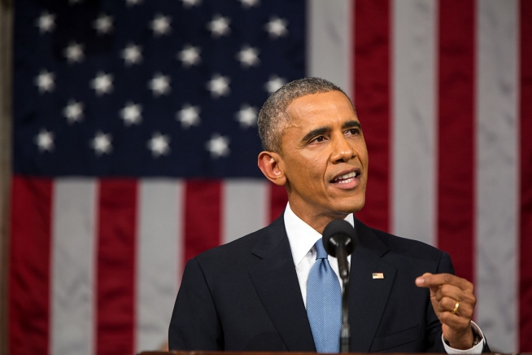
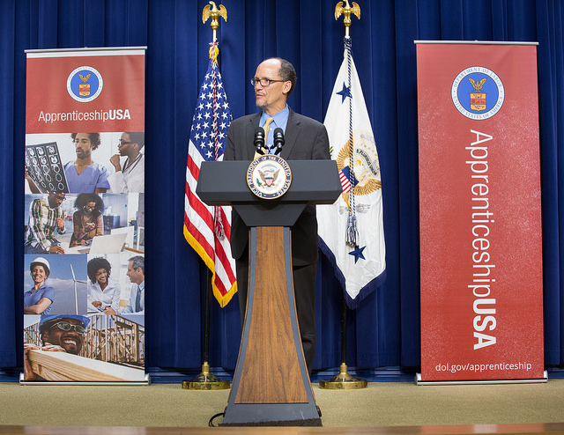
Over the past two years, Registered Apprenticeship has been in the workforce-development spotlight.
Tonight, I'm also asking more businesses to follow the lead of companies like CVS and UPS, and offer more educational benefits and paid apprenticeships -- opportunities that give workers the chance to earn higher-paying jobs even if they don't have a higher education.
– President Obama, State of the Union - 2015
LEADER White House Convening
September 2015
…Train Americans with the skills employers need, and match them to good jobs that need to be filled right now. That means more on-the-job training, and more apprenticeships…
- President Obama, State of the Union - 2014
American Apprenticeship Grants
$175 Million!

Slide 3
ApprenticeshipUSA continues to grow.
750,000
500,000
FY 16 Annual Goal
456,989
Quarter 2 - FY 16
Number of Active Apprentices
375,000

Slide 4
Expansion for Fiscal Year 2016: $90 Million for American Apprenticeship Grant program
This historic new program has the potential to increase alignment with more Community Colleges by providing classroom instruction for apprenticeships and ensuring States support college credit for apprenticeship:
States: Build state capacity to administer RA programs;
Industry: Build on American Apprenticeship grant and expand apprenticeship beyond H1B targeted occupations and industries;
Under-Represented Populations: Support community-based organizations and workforce intermediaries on innovative strategies for career pathways;
National Activities: Increase national outreach, technical assistance, and capacity building needs;
Office of Apprenticeship
US Department of Labor | Employment and Training Administration

Slide 5
Common Components of Registered Apprenticeship
Employer Involvement Is Integral
Employer is the foundation for the RA program and must be directly involved and provider of OJT
Structured On-the-Job Training
with Mentoring
Minimum of 2,000 hours Structured and Supervised
Related Training and Instruction
144 hours recommended per year
Parallel | Front-loaded | Segmented Options
Rewards for Skill Gains
Increases in skills brings about increases in earnings
National Occupational Credential
Nationally recognized credential showing job proficiency Sponsor certifies individual is fully competent for career

Slide 6
Registered Apprenticeship delivers results for workers and the nation.
Impressive Public Benefits
$27 in benefits for every $1 invested by Government*
Strong Outcomes
Completers earn $50,000 per year on average with career pathways
90% of completers employed
Opportunities to earn college credit
Over $300,000 more than their peers in life-time earnings
OUTCOMES AND RESULTS

Slide 7
ApprenticeshipUSA Accelerator Sessions
Opportunity for businesses and other industry stakeholders to rapidly develop and register apprenticeship programs.
Focus on Advanced Manufacturing, Energy, Healthcare,
IT, Transportation and Logistics, and others TBD
Notes:
ApprenticeshipUSA Accelerator Meetings – In 2016, OA will hold a series of ApprenticeshipUSA Accelerator meetings in targeted industries from. While the specific objectives of these meetings will vary by industry, the overall goal is to simplify and streamline the process of building and registering apprenticeship programs in order to rapidly grow the number of apprentices across the United States.

Slide 8
Apprenticeship and Maritime
Congestion and breakdowns a key issue
Unions are concerned about job loss
Registered Apprenticeship is an effective way to address the need for high-skilled workers
Works in union and non-union settings
Training for both incumbent and new workers

Slide 9
Registered Apprenticeship in Maritime
Oceaneering, LLC | AMSEC, International | Seafarers International Union
Machinist Outside Marine Pipefitter Machinist Inside Industrial Engineering Technician Ship fitter Sheet Metal Worker Welder (4 year) Electrician (4 Year) Quality Control Assembly Test Technician Non-Destructive Tester Rigger | Marine Service Technician Electrician (Ship and Boat) Elevator Repairer (Mechanical) Elevator Repairer (Electrical) Maintenance Repairer (Industrial) Welder Combination Pipefitter Machinist Inside Mechanical Engineering Technician | Chief Cook Able Seaman Fireman Oiler Water Tender

Slide 10
Registered Apprenticeship in Maritime/Seaports
Next Steps—
Building towards a Seaports Accelerator convening in late fall
Working with SMART (Southeast Maritime & Transportation Center) on outreach to employers & their unions
Meeting June 29-30 hosted by Houston Port Authority with several ports, companies, colleges
Welcome your participation & leadership

Slide 11
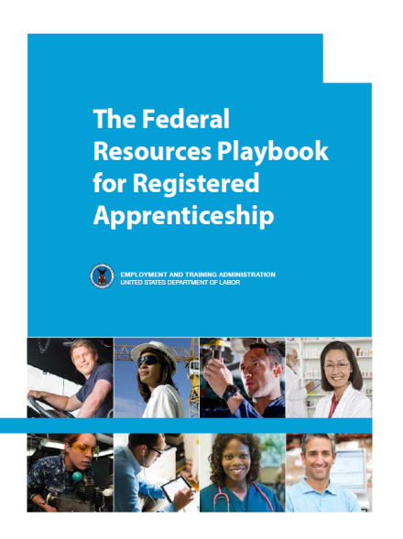
DOL.GOV/Apprenticeship: New Resources
Quick-Start Toolkit
5 Step Format to take you from “exploring” to “launching” a Registered Apprenticeship Program.
http://www.doleta.gov/oa/employers/apprenticeship_toolkit.pdf
Federal Resources Playbook for Registered Apprenticeship
Guide to resources from the Departments of Labor, Education, Veterans Affairs, Agriculture, Transportation, and Housing and Urban Development to support Registered Apprenticeship
http://www.doleta.gov/oa/federalresources/playbook.pdf
DOL Registration Site
An electronic apprenticeship standards builder that allows potential new sponsors to build and register their program online.
http://www.doleta.gov/oa/registration/
RACC Site
Find information on becoming a RACC member and a database of college members and sponsors.
https://www.doleta.gov/oa/racc.cfm

Slide 12
Questions? Thank you for Your Participation
Laura Ginsburg
Office of Apprenticeship
US Department of Labor
202-693-2803
Ginsburg.laura@dol.gov
Notes:
Questions-Answers

